Slide 1
Age Detection using Face Images

Slide 2
Introduction
Estimating facial attributes plays a crucial role in vast potential applications of multimedia communication and human machine interaction.
The age progression displayed on faces is uncontrollable and personalized.
Manifold learning methods are used to find a sufficient low-dimensional embedding space.
One of the methods of feature extraction is using LPP, in which facial features are extracted from an appearance-based shape-texture model.
SVM is applied on an input face image represented by a set of fitted model parameters to estimate classification vector.
A large size data set should have a significant trend for underlying sequential patterns, since each face image has a unique age label.
Learned feature and classified features are used to estimate age of a new image.

Slide 3
Problem Statement
Human age detection using facial images as input data.

Slide 4
Literature Review
It was necessary to reduce the dimensionality of a data set consisting of many variables correlated with each other, either heavily or lightly, while retaining the variation present in the dataset, up to the maximum extent.
The same is done by transforming the variables to a new set of variables, which are known as the principal components.
Existing age estimation techniques used face, appearance model, aging pattern subspaces, age manifolds, age classification/regression.
We studied 2 cases: [1]
How much can age estimation performance be affected by gender ?
Case 1: age estimation is performed on all faces without discriminating between males and females
Case 2: age estimation is performed for males and females separately, with the assumption that gender is known.
How significantly can age estimation errors be reduced if the estimations are performed on smaller gender and age groups ?

Slide 5
Approaches and accuracies we studied: [2] (i)OLPP (ii)BIF+OLPP (iii) BIF+PCA (iv) BIF+LSDA (v) BIF+MFA
Age Estimation error was lower in BIF+LSDA i.e. 2.95
Automatic age estimation can have better results than the corresponding mixed age estimation for all four representations, although the gender classifications are not perfect.
BIF+LSDA for age estimation, which has the highest gender classification accuracy.
BIF+MFA representation performs the worst for gender classification, thus raising the MAE, although it has the smallest MAE for age estimation with mixed gender.
All representations have larger errors than other when gender is known.

Slide 6
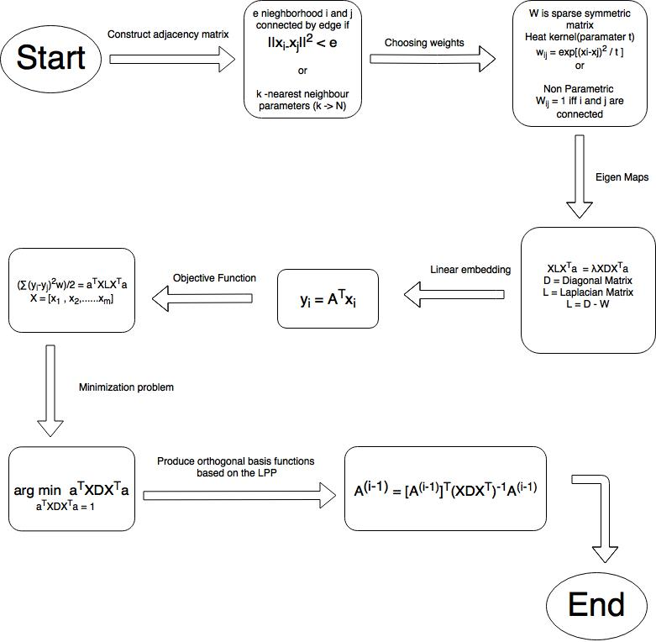
APPROACH
[3][4]
1) After dimensionality reduction using PCA, features were extracted using LPP.
2) SVM was implemented on this extracted features to classify into three classes.

Slide 7
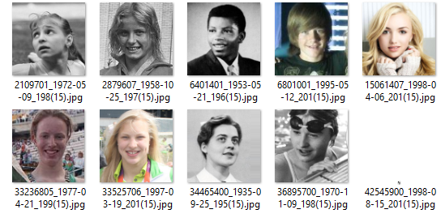

Implementation & Results
We first found the age of the person in the image from the name of the image. Then image was renamed by appending the age to the name of the image.
Next, the images representing same age were added to a same folder named as the age digits. Like the images whose subject has age 15 are added to the folder named “15”.
The images were processed to extract features using LPP. On applying LPP, we found L, D and W vectors and eventually found out eigen vector A.
SVM is applied on these features to classify them into 3 classes i.e. yound, adult and old.
Whenever new image is given as an input, it will be classified based on this SVM classifier.

Slide 8
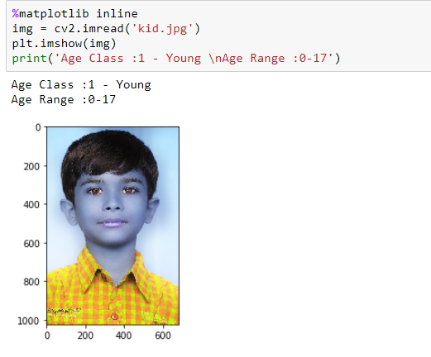
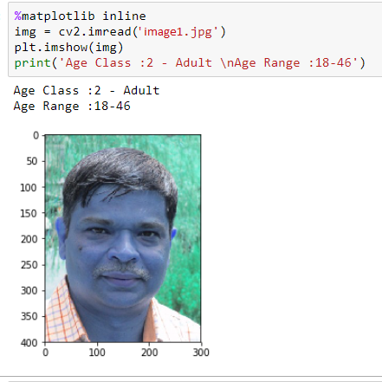
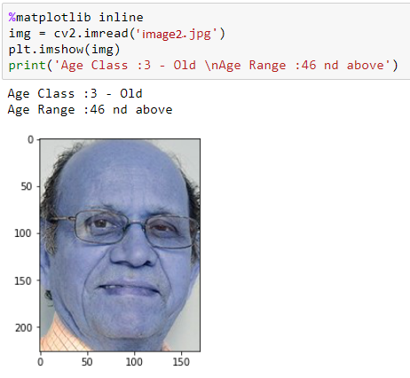
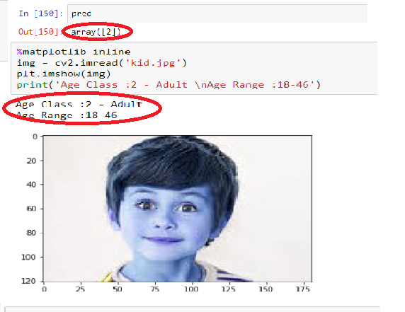
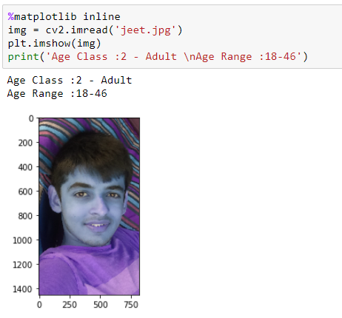
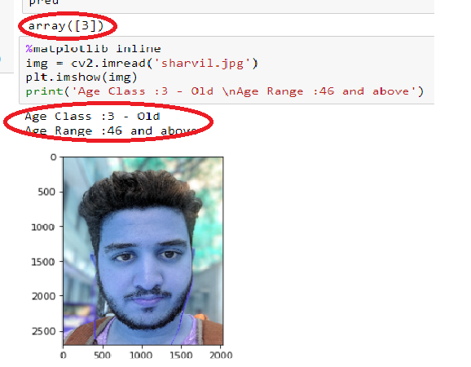
Discussions
[6]
[7]

Slide 9
Conclusion & Future Work
While dealing with the facial variations in the context of machine learning, age estimation has been an explored domain. Age variations present several unique which make age recognition a challenging task to be studied.
Our basic idea is to model an aging pattern defined by individual’s face images such that the dimensionality and hence the cost of computation is reduced.
We are motivated in performing the dimensionality reduction through PCA approach but the differentiating ground being the consideration of underlying data manifold structure as well.
After performing dimensionality reduction (which is indeed a crucial part), we used LPP to extract the features from those images.
We implemented Support Vector Machine to draw a hyperplane separating the features of young and adult and to compute the age range of an inputted image.
We would like to base our approach in defining more ranges for precise age classification and detection problem.

Slide 10
References
[1] Guo, G., Mu, G., Fu, Y., Dyer, C. and Huang, T., 2009, September. A study on automatic age estimation using a large database. In Computer Vision, 2009 IEEE 12th International Conference on (pp. 1986-1991). IEEE.
[2] Fu, Y., Xu, Y. and Huang, T.S., 2007, July. Estimating human age by manifold analysis of face pictures and regression on aging features. In Multimedia and Expo, 2007 IEEE International Conference on (pp. 1383-1386). IEEE.
[3] VAISHNAVI, M. and VIJAYALAkSHMI, A., 2017. Age Estimation using OLPP Features.
[4] Wang, R., Nie, F., Hong, R., Chang, X., Yang, X. and Yu, W., 2017. Fast and orthogonal locality preserving projections for dimensionality reduction. IEEE Transactions on Image Processing, 26(10), pp.5019-5030.
[5] Fu, Y., Guo, G. and Huang, T.S., 2010. Age synthesis and estimation via faces: A survey. IEEE transactions on pattern analysis and machine intelligence, 32(11), pp.1955-1976.
Thank You !

